Slide 1
CapStone Project
Launching a Hair Salon Business in New York
Suresh Packirisamy

Slide 2
Business Summary The salon industry is growing steadily and is projected to continue growing. They estimate that the global spa and beauty salon market should reach approximately 190.81 billion USD in 2024. In the U.S. alone, the salon industry is estimated to be worth $47.1 billion, and the market size is expected to increase by 1.5 percent in 2020.

Slide 3
Problem Statement A hair salon / spa owner wants to relocate to the New York state from California. There are lots of key factors have to be analyzed before he gets relocated to New York and starts his business. The first question that needs to be answered is the Location of the Shop. Is the location is well populated, does it have good neighborhoods around, what is the crime rate of this location, how many salons are there on the same city. Also the salon should be in close proximity of metro stations as it would attract the commuters. Considering all these factors, applying data science in this process would help in decision making process.

Slide 4
Data Set
Data Set | Description
Total Population | We would need the detailed data on population with the postal code to predict where the business owner would get more clients. This will be the base master data set and it can be obtained from the open source population data from New York City website. https://data.cityofnewyork.us/resource/swpk-hqdp.csv https://www.newyork-demographics.com/cities_by_population
Existing Salon Count | NYC.gov provides the list of businesses with the location details. This would help to determine how many salons exist in the selected locations. The more shops would increase the competition to the business. The spa owner will be more interested in the locations with less salons / spa. We would get the total number of salons by grouping the city. At the end, this data will be merged with the master data set. https://data.ny.gov/api/views/84h5zxa9/rows.json?accessType=DOWNLOAD&sorting=true https://data.ny.gov/Economic-Development/Upstate-New-York-Hair-Salons/84h5-zxa9
Income Data | Good economy is a key factor to run the business successfully with out any loss. Hence we are considering the income level of the community where owner planning to start the business. https://data.ny.gov/api/views/bui8-bb6g/rows.csv?accessType=DOWNLOAD

Slide 5
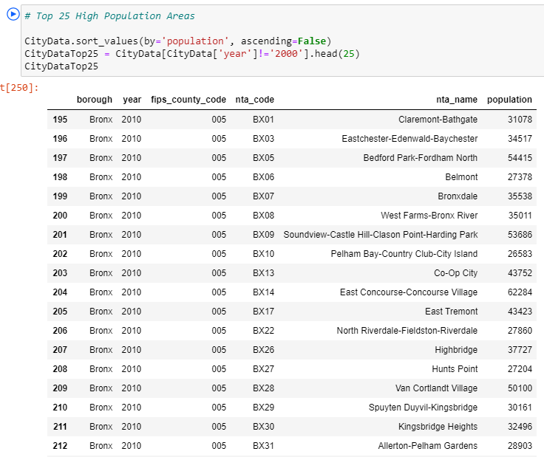
Approach
Get the list of all the cities with population details and Identify top 25 Cities with high population

Slide 6
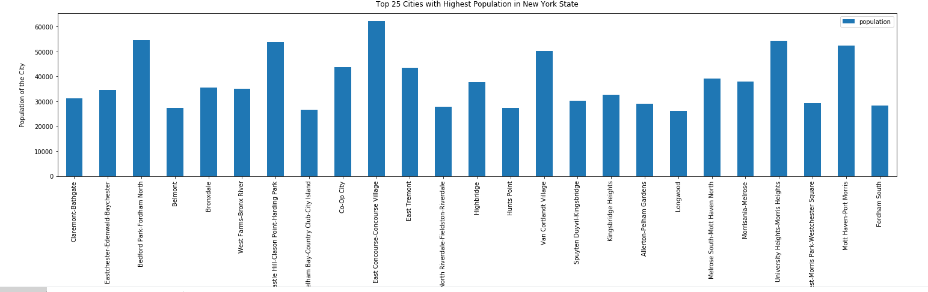
Project the top 25 cities with high population using Bar chart for better analysis

Slide 7
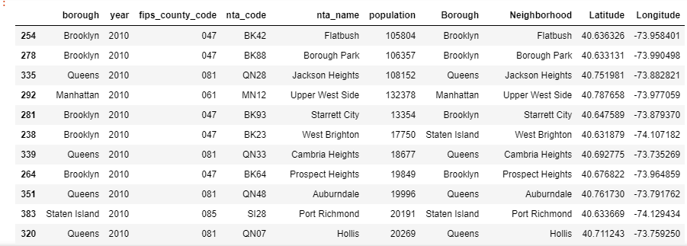
Get the Latitude and Longitude of the locations to explore the neighborhood.

Slide 8
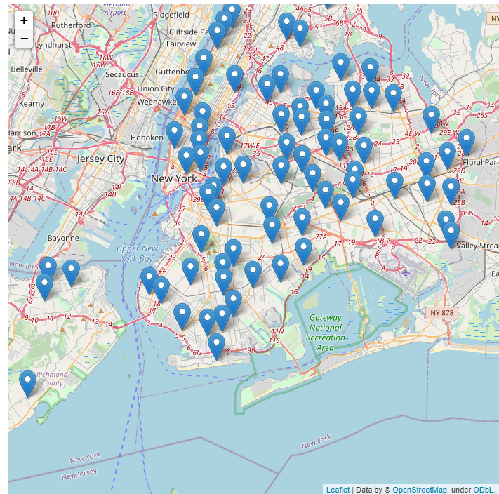
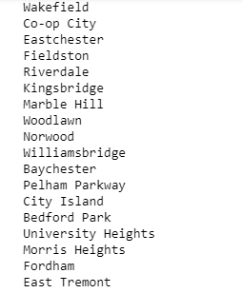
Explore the neighborhood using folium map
Neighborhood Area’s

Slide 9
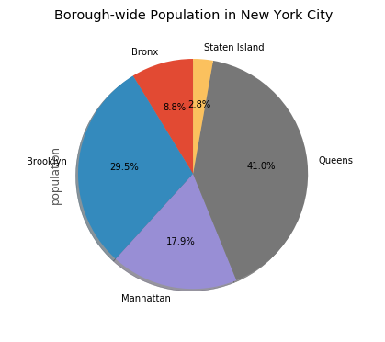
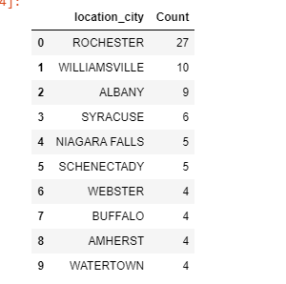
1. Get the exisiting Salon Count – Less number of shops attracts more businesses
2. Identify the boroughs that has more population for better opportunity
Cities to be Avoided:
Borough needs to be focused:

Slide 10
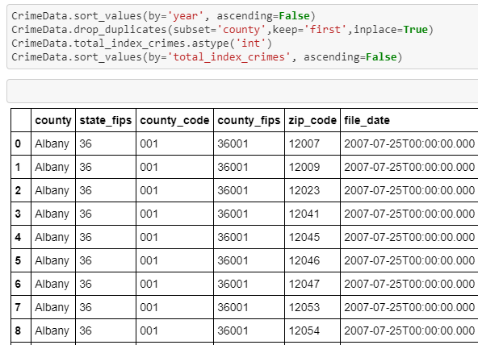
Crime Data Report - Optional
The spa owner might be interested in Crime Data to make sure the amount of risk is less.

Slide 11
Conclusion:
Listed out top 25 locations around New york state with neighborhood locations
Provided the list of places to avoid based on the Crime Data Rate and number of existing salons
Provided the interactive map with the place holder for chosen locations
The owner can explore more using this map

